Slide 1
Sampling of Continuous-Time Signals (Chapter-4) Dr. Ahmad Salman BEE
Content and Figures are from Discrete-Time Signal Processing, 2e by Oppenheim, Shafer, and Buck, ©1999-2000 Prentice Hall Inc.

Slide 2
Signal Types
Analog signals: continuous in time and amplitude
Example: voltage, current, temperature,…
Digital signals: discrete both in time and amplitude
Example: attendance of this class, digitized analog signals,…
Discrete-time signal: discrete in time, continuous in amplitude
Example:hourly change of temperature
Theory for digital signals would be too complicated
Requires inclusion of nonlinearities into theory
Theory is based on discrete-time continuous-amplitude signals
Most convenient to develop theory
Good enough approximation to practice with some care
In practice we mostly process digital signals on processors
Need to take into account finite precision effects

Slide 3
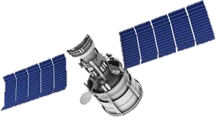

Why we need sampling
Analog GeoSat Communication Channels

Slide 4
Why we need sampling
Analog GeoSat Communication Channels
Inter-Satellite Communication
Satellite-Earth Station
Communication

Slide 5
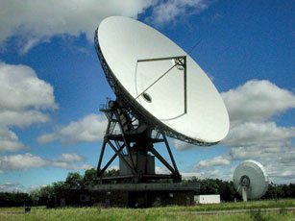
Why we need sampling
Discrete-time work at satellite and Earth Station
Signal Denoising
Signal Error Correction
Signal Enhancement
Channel Equalization
Signal Denoising
Signal Error Correction
Signal Enhancement
Channel Equalization
Signal Resizing
Signal Classification
Pattern Matching
Signal Prediction

Slide 6
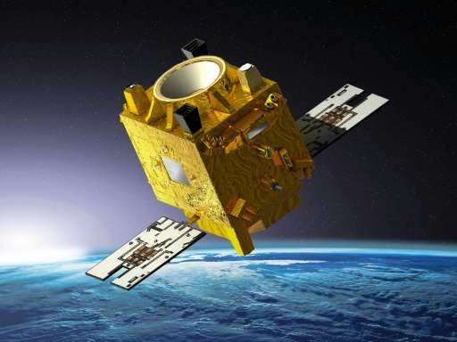
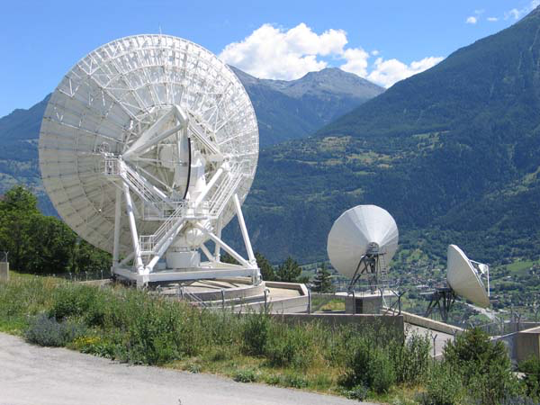
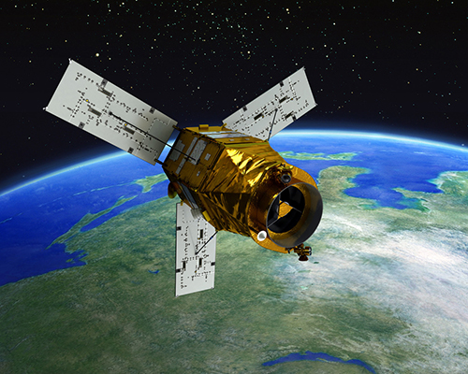
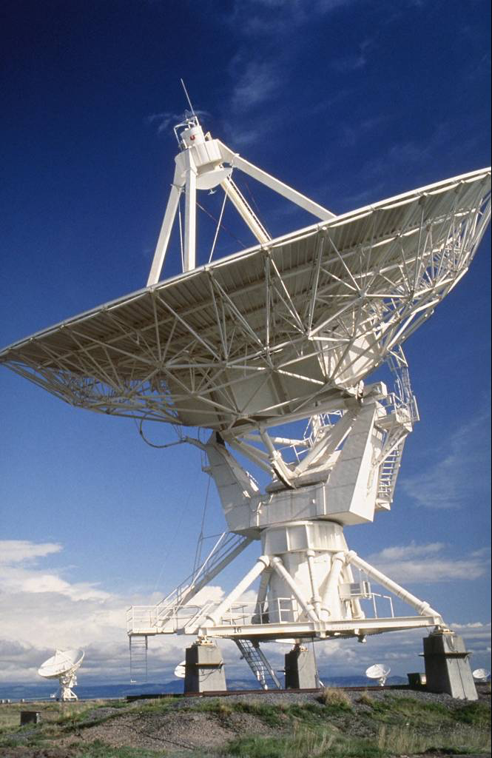
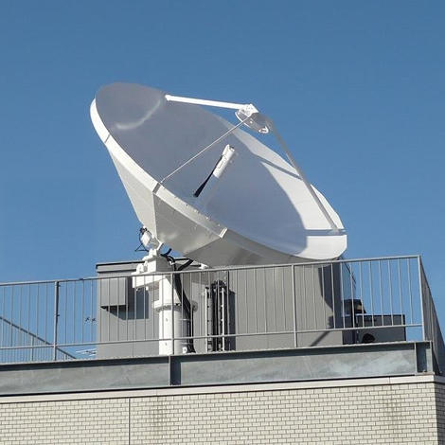
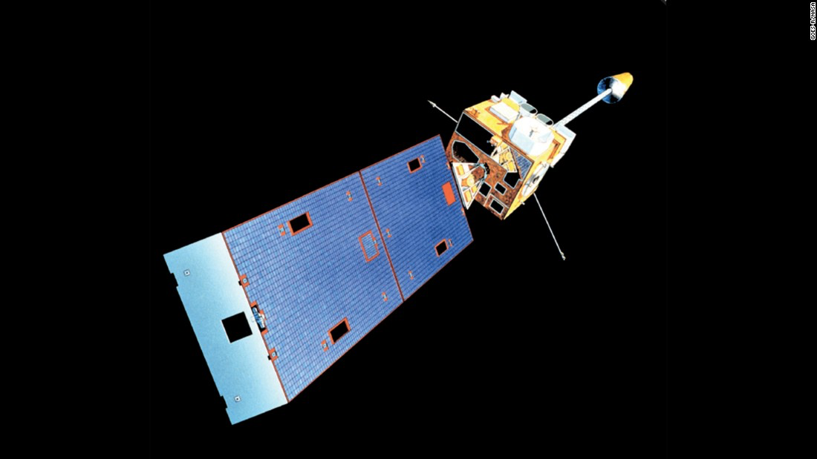
Why we need sampling
Different hardware at different Earth-Stations and at different satellites

Slide 7
Why we need sampling
Different hardware at different Earth-Stations and different satellites
So, we need to study
Sampling and it’s criteria
Downsampling
Upsampling

Slide 8
Periodic (Uniform) Sampling
Sampling is a continuous to discrete-time conversion
Most common sampling is periodic
T is the sampling period in second
f_{s} = 1/T is the sampling frequency in Hz
Sampling frequency in radian-per-second Ω_{s}=2πf_{s} rad/sec
Use [.] for discrete-time and (.) for continuous time signals
This is the ideal case not the practical but close enough
In practice it is implement with an analog-to-digital converters
We get digital signals that are quantized in amplitude and time
-3
-2
-1
0
1
2
3
4

Slide 9
Periodic Sampling
Sampling is, in general, not reversible is not done properly
Given a sampled signal one could fit infinite continuous signals through the samples
1
0.5
0
-0.5
-1
0
20
40
60
80
100
Fundamental issue in digital signal processing
If we lose information during sampling, we cannot recover it (Aliasing)
Under certain conditions an analog signal can be sampled without loss so that it can be reconstructed perfectly

Slide 10
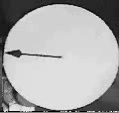
Sampling Demo
In this movie the video camera is sampling at a fixed rate of 30 frames/second.
Observe how the rotating phasor aliases to different speeds as it spins faster.
Demo from DSP First: A Multimedia Approach by McClellan, Schafer, Yoder

Slide 11

Sampling Demo
In this movie the video camera is sampling at a fixed rate of 30 frames/second.
Observe how the rotating phasor aliases to different speeds as it spins faster.

Slide 12
Representation of Sampling
Mathematically convenient to represent in two stages
Impulse train modulator
Conversion of impulse train to a sequence
s(t)
x_{s}(t)
Convert impulse train to discrete-time sequence
x_{c}(t)
x
x[n]=x_{c}(nT)
x_{c}(t)
x[n]
s(t)
t
n
-3T
-2T
-T
0
T
2T
3T
4T
-3
-2
-1
0
1
2
3
4

Slide 13
Continuous-Time Fourier Transform
Continuous-Time Fourier transform pair is defined as
We write x_{c}(t) as a weighted sum of complex exponentials
Remember some Fourier Transform properties
Time Convolution (frequency domain multiplication)
Frequency Convolution (time domain multiplication)
Modulation (Frequency shift)

Slide 14
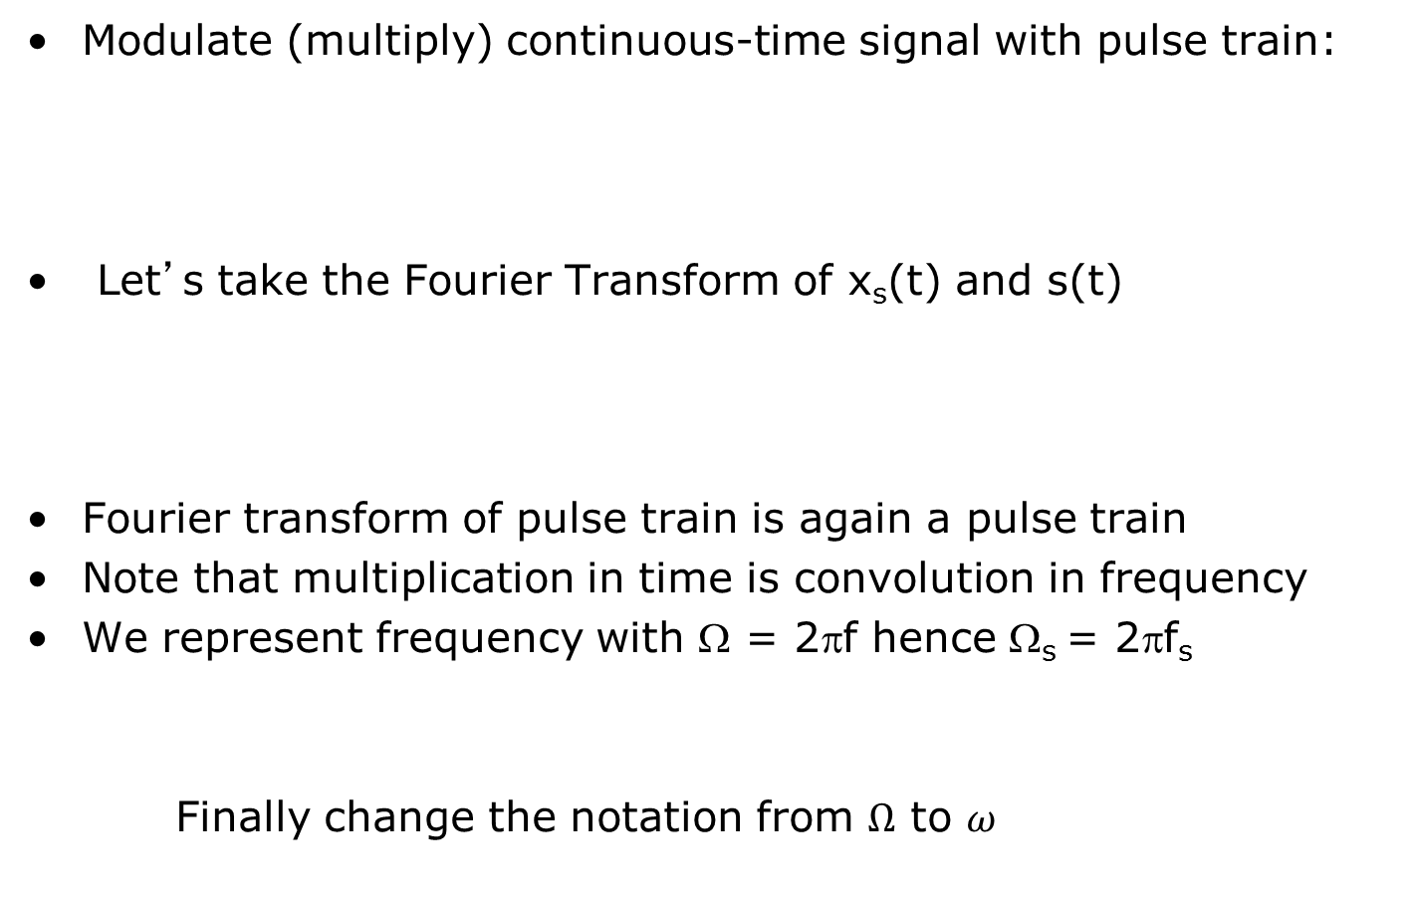
Frequency Domain Representation of Sampling
Why?

Slide 15
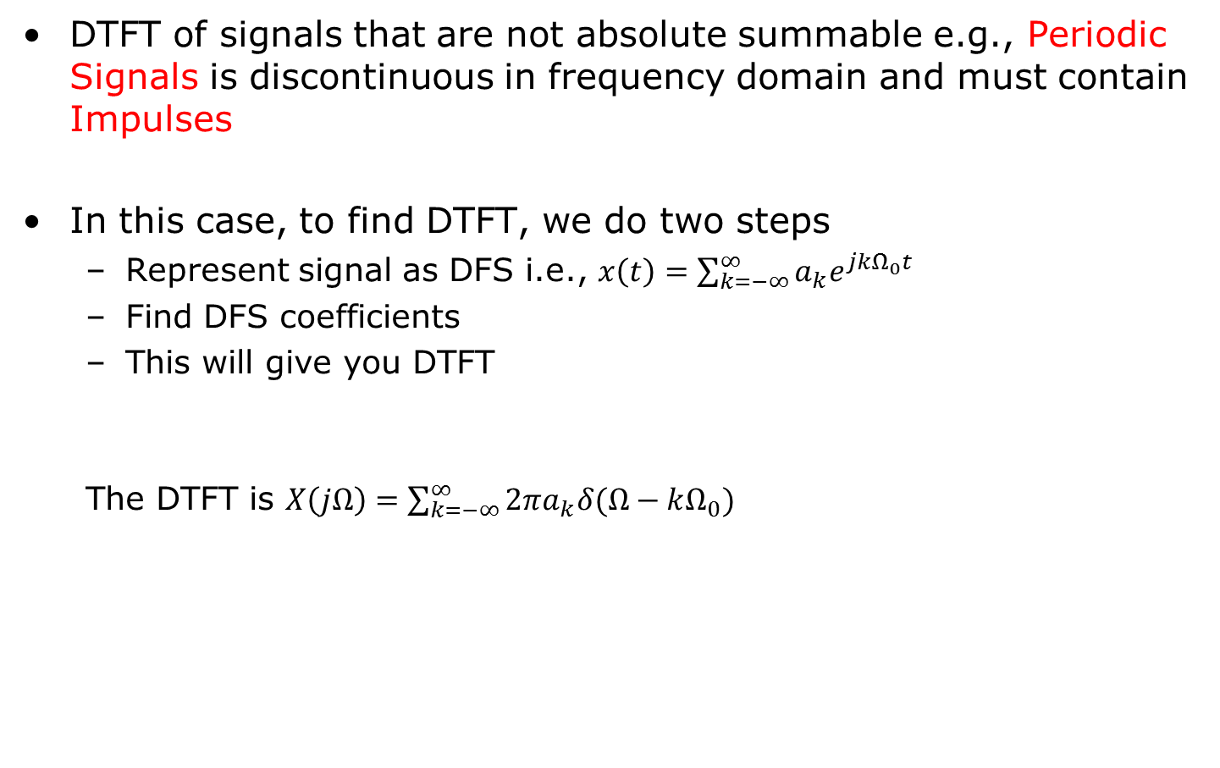
Very Important
C
C
C
C

Slide 16
Frequency Domain Representation of Sampling
Convolution with pulse creates replicas at pulse location:
This tells us that the impulse train modulator
Creates images of the Fourier transform of the input signal
Images are periodic with sampling frequency
If Ω_{s}< 2Ω_{N} sampling maybe irreversible due to aliasing of images
-Ω_{N}
Ω_{N}
Ω_{s}>2Ω_{N}
3Ω_{s}
-2Ω_{s}
Ω_{s}
-Ω_{N}
Ω_{N}
Ω_{s}
2Ω_{s}
3Ω_{s}
Ω_{s}<2Ω_{N}
3Ω_{s}
-2Ω_{s}
Ω_{s}
-Ω_{N}
Ω_{N}
Ω_{s}
2Ω_{s}
3Ω_{s}

Slide 17
Frequency Domain Representation of Sampling
Why is Spectrum drawn symmetric?
-Ω_{N}
Ω_{N}
Ω_{s}>2Ω_{N}
3Ω_{s}
-2Ω_{s}
Ω_{s}
-Ω_{N}
Ω_{N}
Ω_{s}
2Ω_{s}
3Ω_{s}
Ω_{s}<2Ω_{N}
3Ω_{s}
-2Ω_{s}
Ω_{s}
-Ω_{N}
Ω_{N}
Ω_{s}
2Ω_{s}
3Ω_{s}

Slide 18
Frequency Domain Representation of Sampling
Why is Spectrum drawn symmetric?
-Ω_{N}
Ω_{N}
Ω_{s}>2Ω_{N}
3Ω_{s}
-2Ω_{s}
Ω_{s}
-Ω_{N}
Ω_{N}
Ω_{s}
2Ω_{s}
3Ω_{s}
Ω_{s}<2Ω_{N}
3Ω_{s}
-2Ω_{s}
Ω_{s}
-Ω_{N}
Ω_{N}
Ω_{s}
2Ω_{s}
3Ω_{s}

Slide 19
Nyquist Sampling Theorem
Let x_{c}(t) be a bandlimited signal with
Then x_{c}(t) is uniquely determined by its samples x[n]= x_{c}(nT) if
Ω_{N} is generally known as the Nyquist Frequency
The minimum sampling rate that must be exceeded is known as the Nyquist Rate
Low pass filter
Ω_{s}>2Ω_{N}
3Ω_{s}
-2Ω_{s}
Ω_{s}
-Ω_{N}
Ω_{N}
Ω_{s}
2Ω_{s}
3Ω_{s}
Ω_{s}<2Ω_{N}
3Ω_{s}
-2Ω_{s}
Ω_{s}
-Ω_{N}
Ω_{N}
Ω_{s}
2Ω_{s}
3Ω_{s}

Slide 20
Reconstruction of Bandlimited Signal From Samples
Sampling can be viewed as modulating with impulse train
If Sampling Theorem is satisfied
The original continuous-time signal can be recovered
By filtering sampled signal with an ideal low-pass filter (LPF)
Impulse-train modulated signal
Pass through LPF with impulse response h_{r}(t) to reconstruct
Convert from sequence to impulse train
Ideal reconstruction filter
H_{r}(jΩ)
x[n]
x_{r}(t)

Slide 21
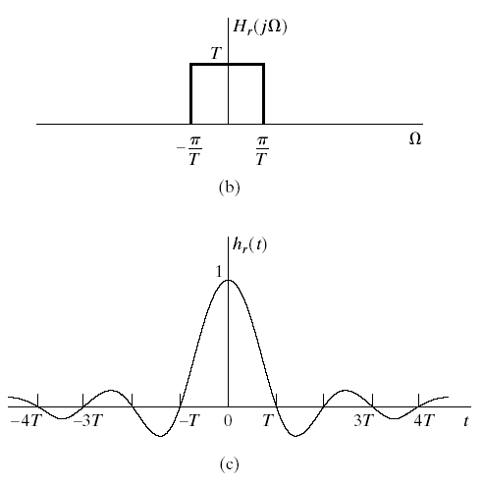
Ideal Reconstruction Filter
Ideal LPF with cut of frequency of Ω_{c}=π/T or f_{c}=1/2T

Slide 22
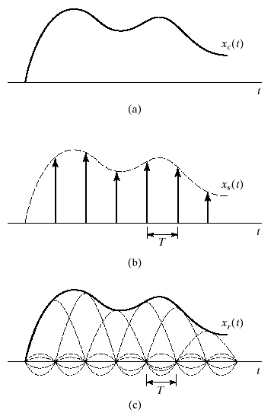
Reconstructed Signal
sinc function is 1 at t=0
sinc function is 0 at nT

Slide 23
Discrete-Time Processing of Continuous-Time Signals
C/D
Discrete-Time
System
D/C
x_{c}(t)
y_{r}(t)
Overall system is equivalent to a continuous-time system
Input and output is continuous-time
The continuous-time system depends on
Discrete-time system
Sampling rate
We’re interested in the equivalent frequency response
First step is the relation between x_{c}(t) and x[n]
Next between y[n] and x[n]
Finally between y_{r}(t) and y[n]

Slide 24
Effective Frequency Response
Input continuous-time to discrete-time
Assume a discrete-time LTI system
Output discrete-time to continuous-time
Output frequency response
Effective Frequency Response

Slide 25
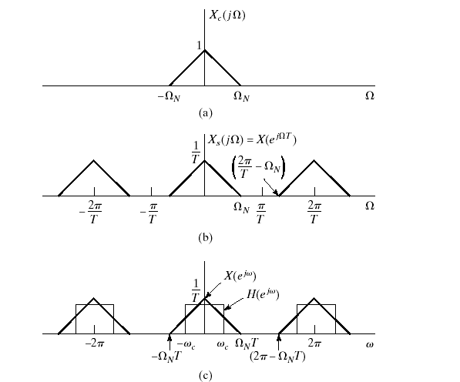
Example
Ideal low-pass filter implemented as a discrete-time system
Continuous-time input signal
Sampled continuous-time input signal
Apply discrete-time LPF

Slide 26
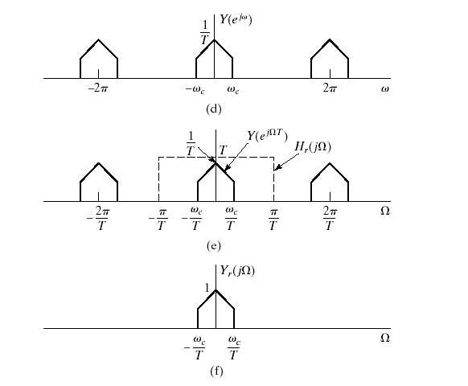
Example Continued
Signal after discrete-time LPF is applied
Application of reconstruction filter
Output continuous-time signal after reconstruction

